Slide 1

ASP.NET
MVC
Trainer xhevat.ibraimi@gmail.com
Assistant dejan.obradovikj@seavus.com

Slide 2
Agenda
ASP.NET MVC
Module 0 - The Boring Part
Where And How It All Began?
HTML Editions
ECMAScript Editions
Static vs Dynamic Website
Dynamic Websites
Web Application Frameworks
Code academy @ Skopje, 2018-2019

Slide 3
Agenda
ASP.NET MVC
Module 1 - Let There Be Light
Various Project Templates
WebForms vs MVC
Creating the first Web Application
MVC Template Project Structure
ASP.NET MVC vs ASP.NET Core template
Code academy @ Skopje, 2018-2019

Slide 4
Agenda
ASP.NET MVC
Module 2 - MVC
MVC Concept
Controllers
Controller Actions
Controller Action Return Types
Views
Razor View Engine
Partial Views And HTML Helpers
Naming Convention
Code academy @ Skopje, 2018-2019

Slide 5
Agenda
ASP.NET MVC
Module 3 - Model
Transfer Data From Controller To View
ViewBag
ViewData
TempData
Model
Model Decoration
Model vs ViewModel
Model Usage
Code academy @ Skopje, 2018-2019

Slide 6
Agenda
ASP.NET MVC
Module 4 - Navigation
Routing by naming Convention
Default Route
Default ActionMethod
Decorating ActionMethod
Controller Base Route
Route Parameters Using Route Attribute
Code academy @ Skopje, 2018-2019

Slide 7
Agenda
ASP.NET MVC
Module 5 - UI and Forms
Creating Views Manually
Using DataBinding and HtmlHelpers
Scaffolding and View Templates
ModelState
Model Validation Attributes
Code academy @ Skopje, 2018-2019

Slide 8
Agenda
ASP.NET MVC
Module 6 - FIlters(Basic)
HTTP Verb Filters
ValidateAntiForgeryToken Filter
ValidateInput Filter
Authorize Filter(only basics)
AllowAnonymous Filter(only basics)
Code academy @ Skopje, 2018-2019

Slide 9
Agenda
ASP.NET MVC
Module 7 - Working With Data(Basic)
Onion Architecture
Mocking Data
Working With In-Memory Database
Data Seed
Code academy @ Skopje, 2018-2019

Slide 10
Agenda
ASP.NET MVC
Module 8 - Multi Layer Architecture
Repository Pattern
Creating First Repositories
Code academy @ Skopje, 2018-2019

Slide 11
Agenda
ASP.NET MVC
Module 9 - Entity Framework
Object Relational Mapper(ORM)
Some famous ORMs
Entity Framework
DbContext
DbSet<>
DbSet<> Operations
Code academy @ Skopje, 2018-2019

Slide 12
Agenda
ASP.NET MVC
Module 9 - Entity Framework
Data Annotation Attributes
Annotation Attributes
DataAnnotations.Schema Attributes
Relationships
One-To-One
One-To-Many
Many-To-Many
Possibilities
Code academy @ Skopje, 2018-2019

Slide 13
Where And How It All Began?
ASP.NET MVC
CERN(1989)
The first Hypertext Transfer Protocol(HTTP)
The first communication between http client and server
The first website
http://info.cern.ch/hypertext/WWW/TheProject.html
Code academy @ Skopje, 2018-2019

Slide 14
HTML Editions
ASP.NET MVC
HTML (1991)
HTML 2.0 (1995)
HTML 3.2 (1997)
HTML 4.01 (1999)
XHTML (2000)
HTML5 (2014)
Code academy @ Skopje, 2018-2019

Slide 15
ECMAScript Editions
ASP.NET MVC
ES 1 (1997)
ES 2 (1998)
ES 3 (1999)
ES 4
ES 5 (2009)
ES 5.1
ES 2015
ES 2016
ES 2017
ES 2018
subitem
Code academy @ Skopje, 2018-2019

Slide 16
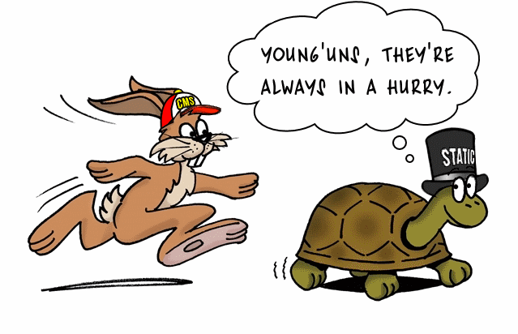
Static vs Dynamic Website
ASP.NET MVC
Code academy @ Skopje, 2018-2019

Slide 17
Dynamic Websites
ASP.NET MVC
Construction is handled by an application server which processes some server-side scripts
The Website is not served as a file but instead it is being generated on every request again and again
Provide possibility to be connected to databases, APIs and other external resources
Code academy @ Skopje, 2018-2019

Slide 18
Web Application Frameworks(just a few)
ASP.NET MVC
ASP.NET MVC (C# or VB)
ASP.NET Core (C# or F#)
ASP.NET WebForms (C# or VB)
WCF (C# or VB)
Spring (Java or Scala)
Django (python)
Ruby on Rails (Ruby)
CodeIgniter (PHP)
Laravel (PHP)
Wordpress (PHP)
Code academy @ Skopje, 2018-2019

Slide 19
?
ASP.NET MVC
Code academy @ Skopje, 2018-2019

